Slide 1


Water Quality Monitoring Dashboard for Kutch Region
By: Kutch, Gujarat India Chapter
https://omdena.com/omdena-chapter-page-india/
DISCLAIMER: This document is strictly private, confidential and personal to its recipients and should not be copied, distributed or reproduced in whole or in part, nor passed to any third party.

Slide 2
Task #3
Satellite Data Imaging Task Leaders : Prathima, Deepali

Slide 3
Problem Statement
To extract the satellite data of Kutch region using Imaging and Open Source Dataset

Slide 4
Completed Work
Literature Review
https://earthdata.nasa.gov/learn/pathfinders/water-quality-data-pathfinder
https://www.ncbi.nlm.nih.gov/pmc/articles/PMC5017463/
https://www.ncbi.nlm.nih.gov/pmc/articles/PMC6111878/
GitHub - robmarkcole/satellite-image-deep-learning: Resources for deep learning with satellite & aerial imagery
Exploring the Data
https://satellites.pro/

Slide 5
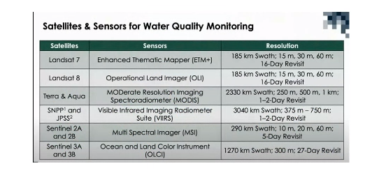
Satellites & Sensors for Water Quality Monitoring

Slide 6
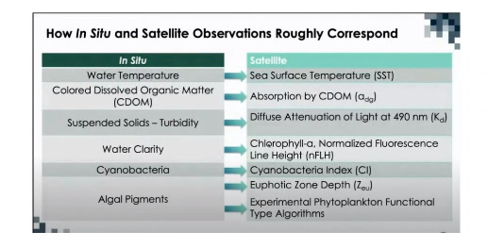
Relating Situ and Satellite Observations

Slide 7
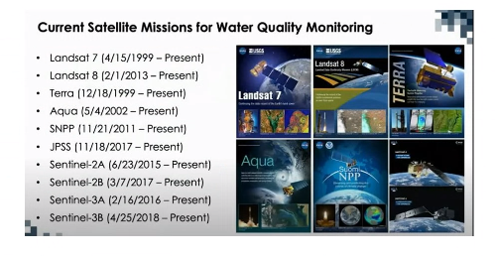
Current Satellite Missions

Slide 8
Work in Progress
Reviewing the literature
LANDSET5, Schematic Mapper Data which has 7 bands and 30*30 meter resolution. Spectral resolution is 16days
LANDSET, Terra and Aqua can be used for identifying Water Color
For sea surface temperature (SST), MODIS and VIIRS can be used

Slide 9
Work In Progress
We are working on extracting the satellite images. For this we had used Python Language
First we had set out a polygon in google earth engine, then tried to retrieve data using Assets / Drive. We’re not aware of where is it downloading. By inbuilt we have import and var statement
Second, when we tried to use geetools library to along with all the relevant parameters. It is showing up an error
We will now try to implement using coordinates, scaling and pixels with startdate, enddate, region.
Since I had requested an approval to use Google Earth and Deepali has her request approved. We had set up a meeting to work together

Slide 10
Future Work- Next Steps
Downloading the Datasets and making appropriate for atmospheric corrections and other input parameters to monitoring the conditions of water bodies.
We might explore these links
Google Earth Engine
Account Login - ArcGIS Online

